Slide 1
Used Car Price Prediction Project
By Amrutha Dhondale

Slide 2
Problem statement
With the Covid 19 impact in the market, we have seen lot of changes in the car market. Now some cars are in demand hence making them costly and some are not in demand hence cheaper. One of our clients works with small traders, who sell used cars. With the change in market duse to Covid 19 impact, our client is facing problems with their previous car price valuation machine learning models. So, they are looking for new machine learning models from new data. We have to make car price valuation model.

Slide 3
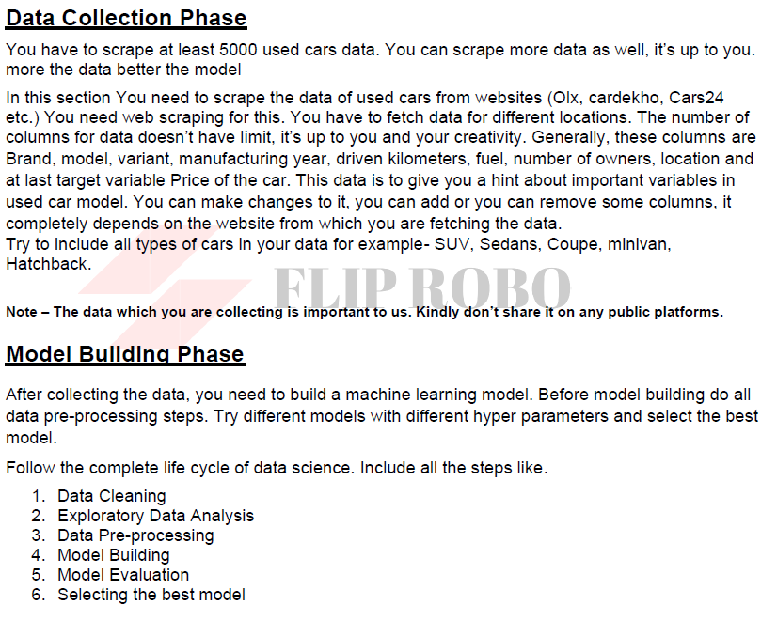
Business Goal & Technical requirement

Slide 4
Steps taken
Collected the data using web driver selenium from carsdekho.com
Identified that this is a regression problem and we have to build a regression model to predict the price.
Data was cleaned during data mining.
Data Visualization helped us to understand the relationship between each feature against the target variable

Slide 5
Steps taken
Following process was followed to clean the data
We dropped the Unnamed column
Length of feature variant was reduced. It will be easy for our machine to understand
Removed 'Petrol+' and change LPG to CNG as it is same fuel
Treated the Null values in Transmission
Removed commas from Driven kilometres and covert it to integer
Removed commas from Price and convert it to integer
Created the new feature “no_year” to check how old the car is

Slide 6
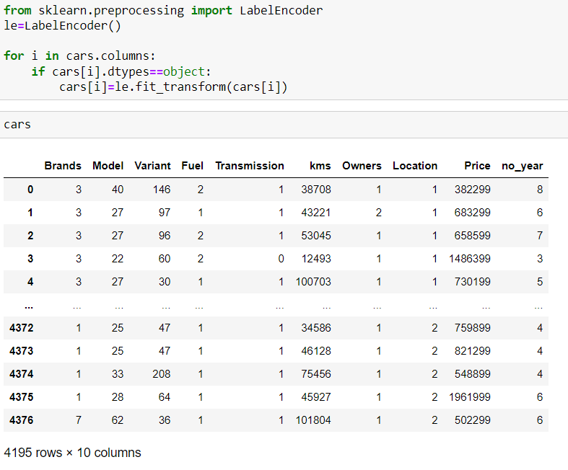
Steps taken
Categorical feature was converted to numerical feature using Label Encoder

Slide 7
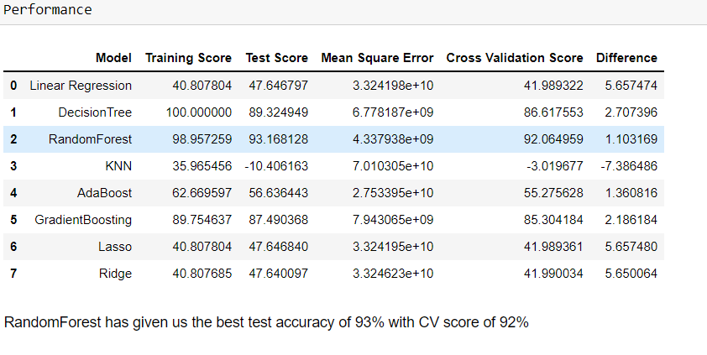
Model Selection
We used various algorithm to train the model. However the model was selected based on the difference between test r2 score and cross validation score.
We selected Random Forest Regressor based on the performance.

Slide 8
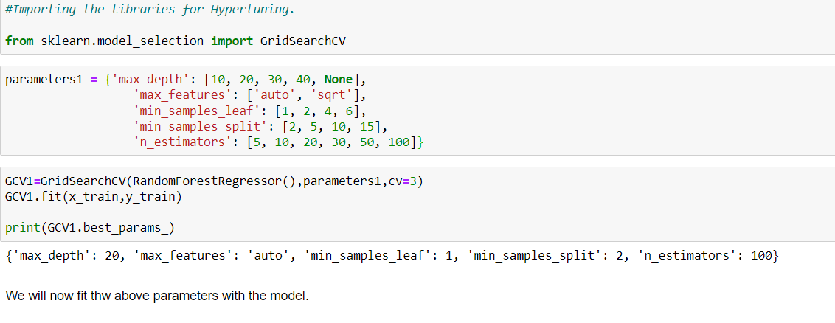
Hyper Tuning
The model accuracy improved slightly after Hypertuning the model

Slide 9
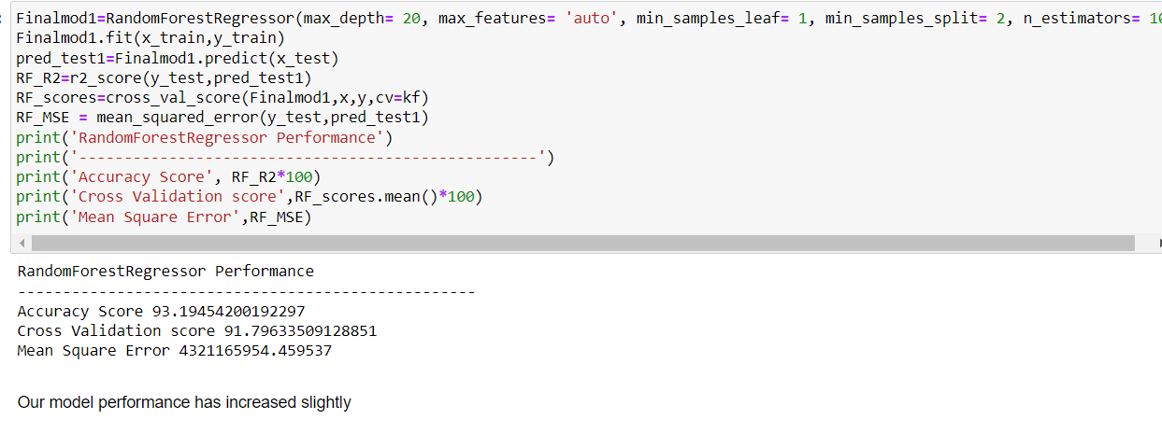
Hyper Tuning

Slide 10
Conclusion
KEY FINDINGS AND CONCLUSIONS OF THE STUDY
In this project we have tried to show how the cars prices vary and what are the factors related to the changing of cars prices. The best was selected using R2 metrics and cross validation score.

